Slide 1
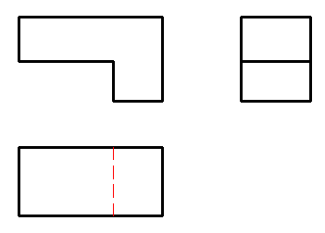
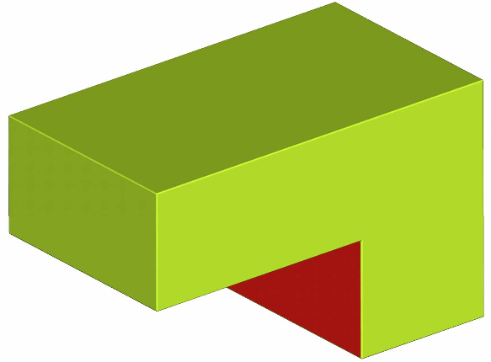

Slide 2
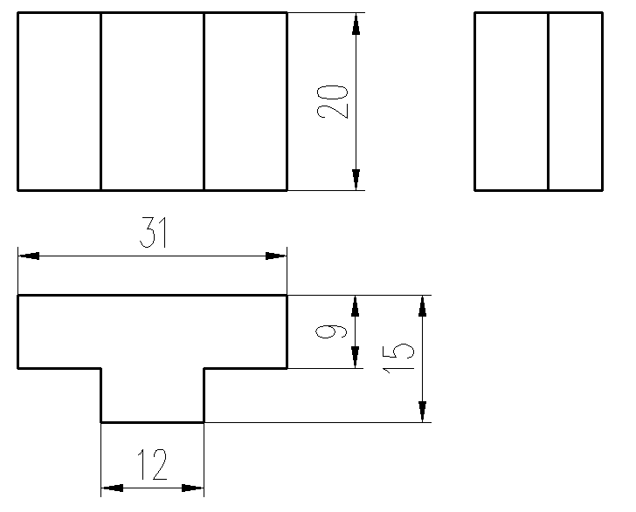
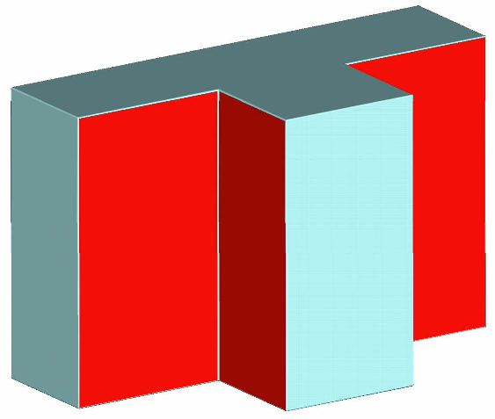

Slide 3
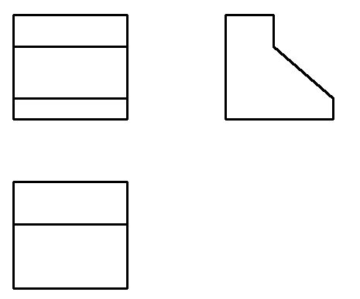
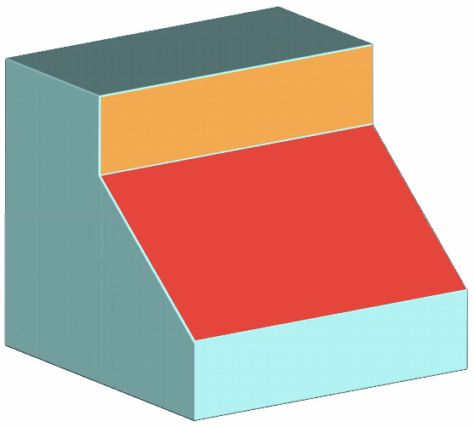

Slide 4
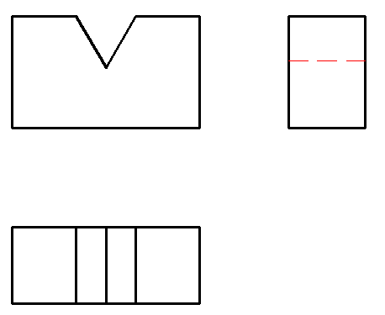
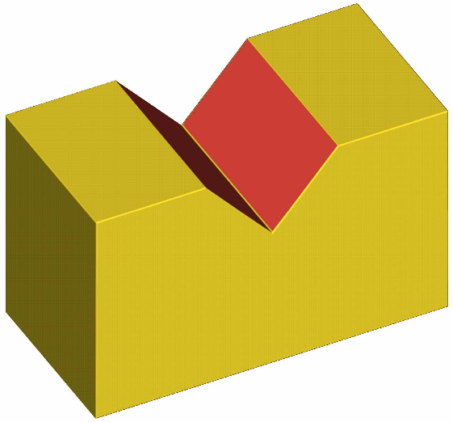

Slide 5
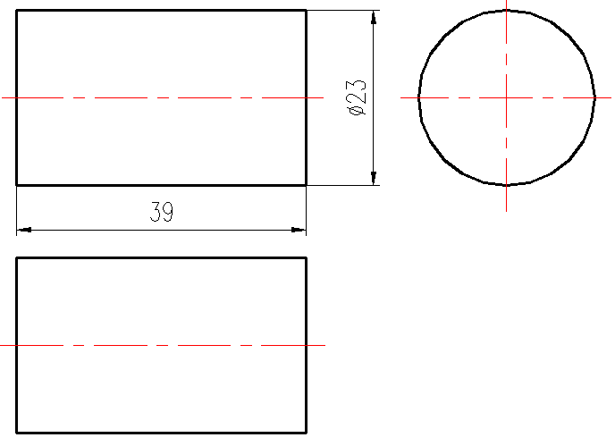


Slide 6
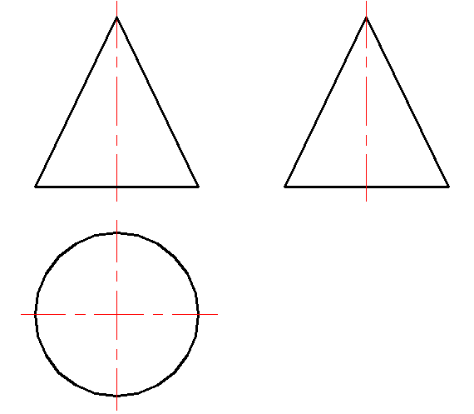


Slide 7
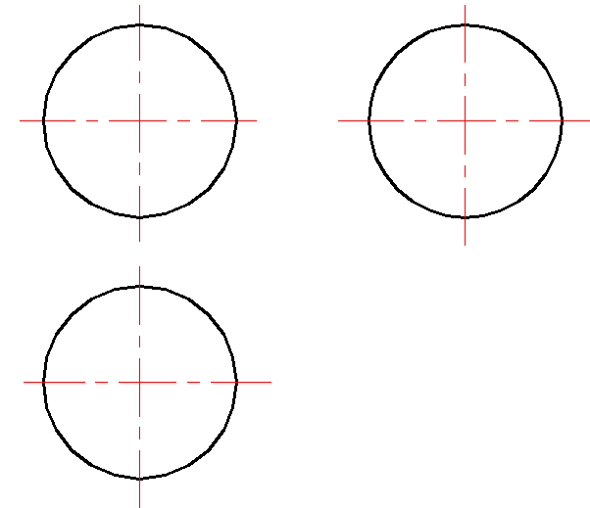
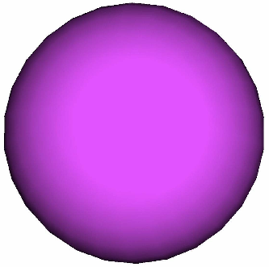

Slide 8
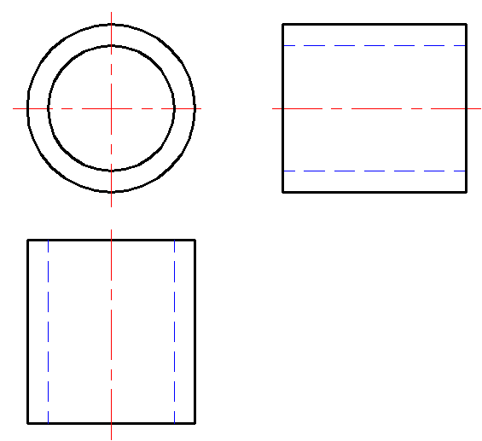
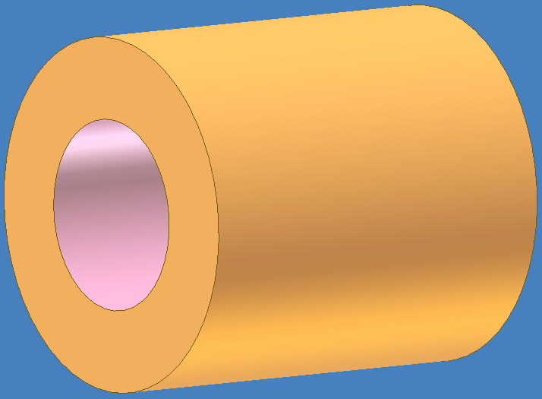

Slide 9
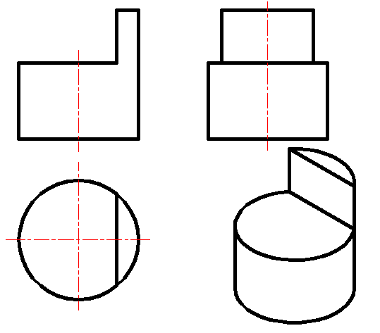

Slide 10
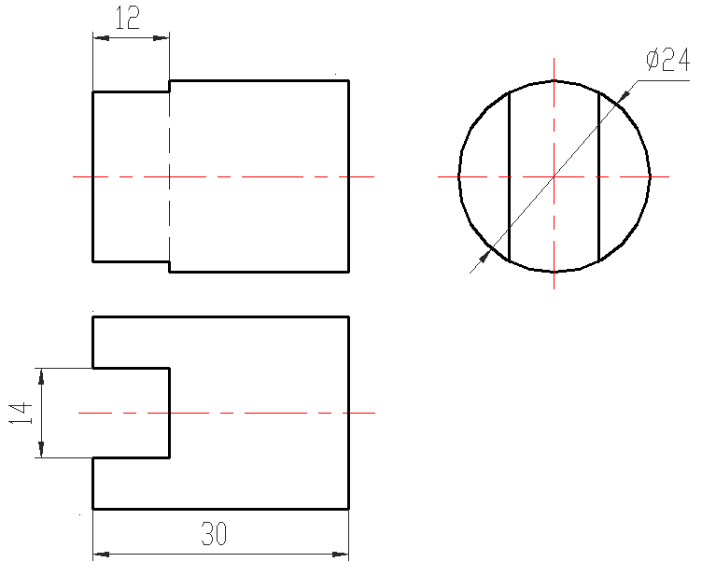
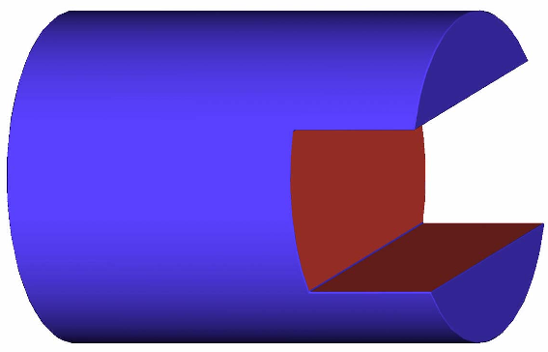

Slide 11
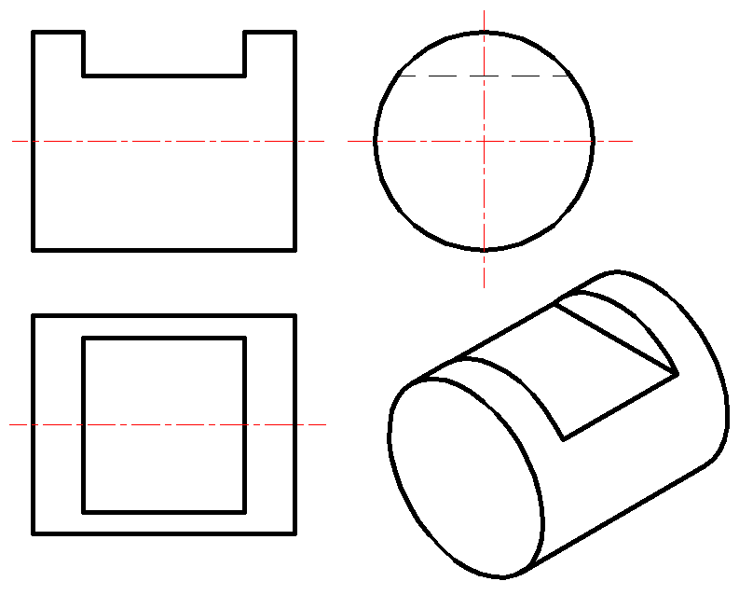

Slide 12
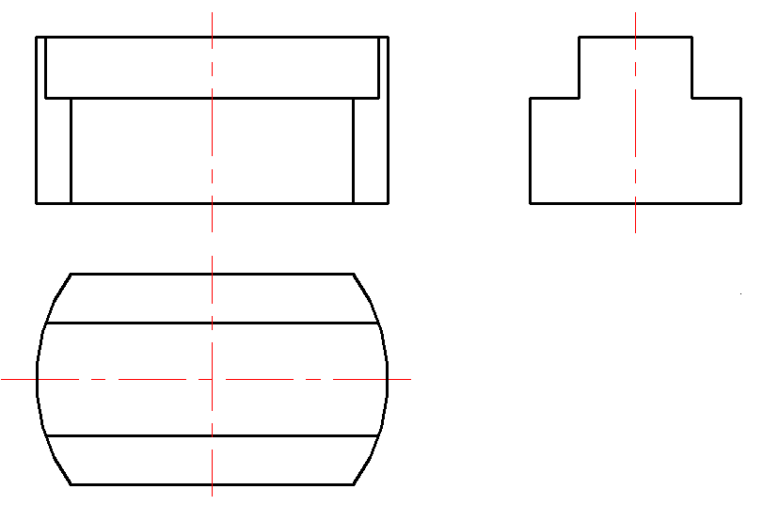
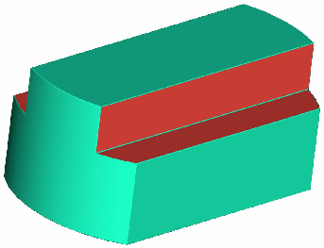

Slide 13
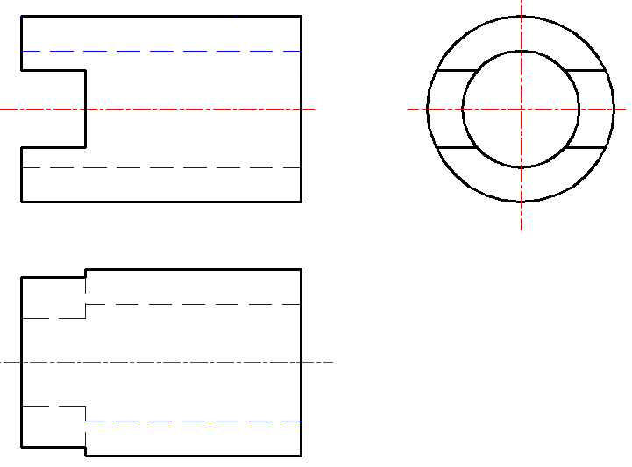
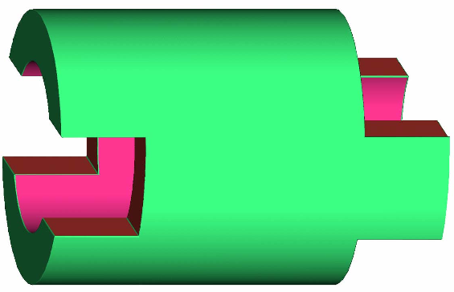

Slide 14
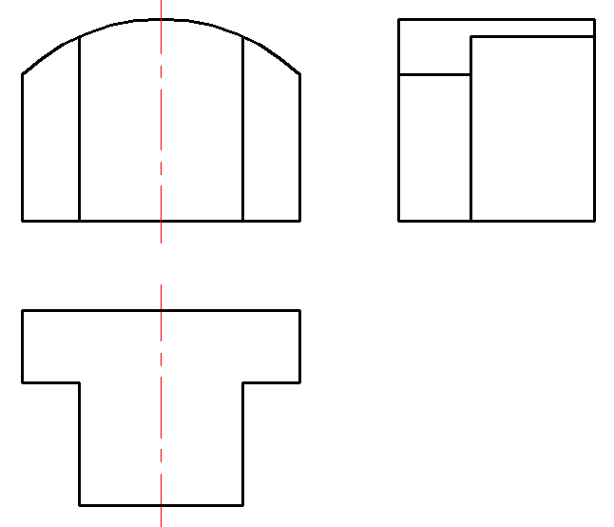
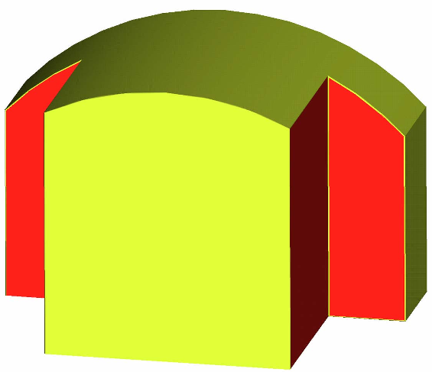

Slide 15
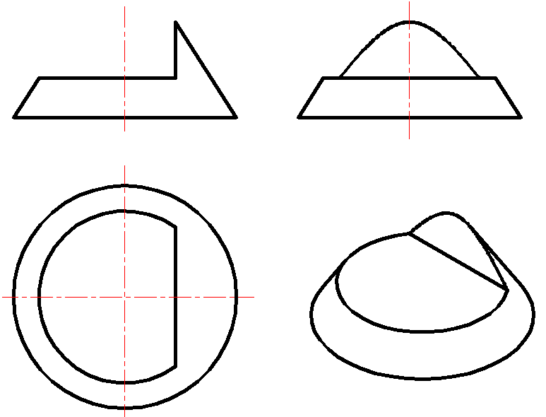

Slide 16
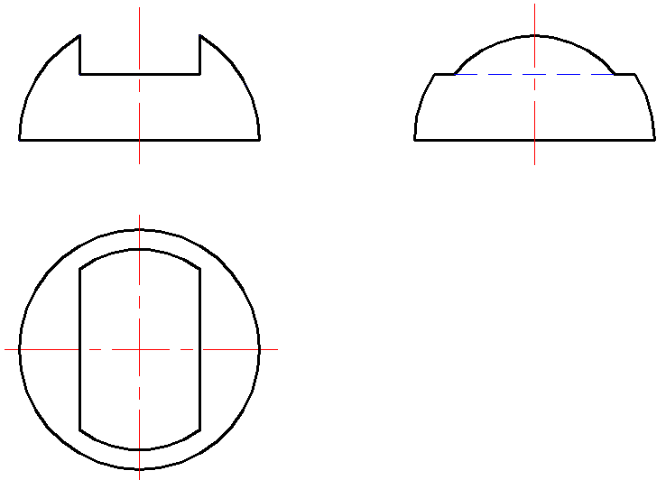
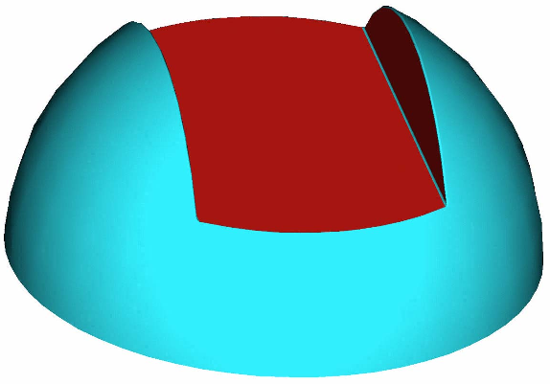

Slide 17
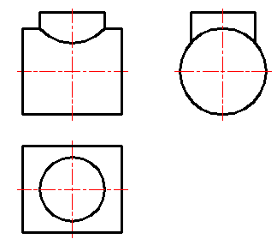
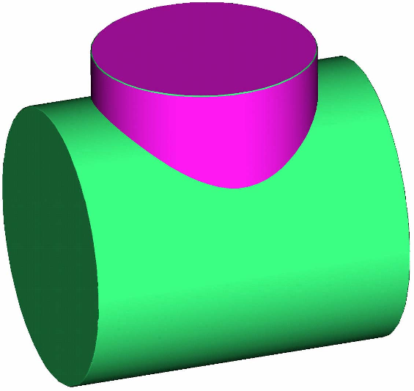

Slide 18
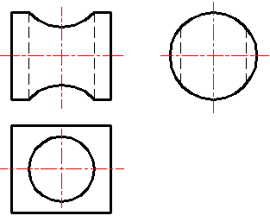
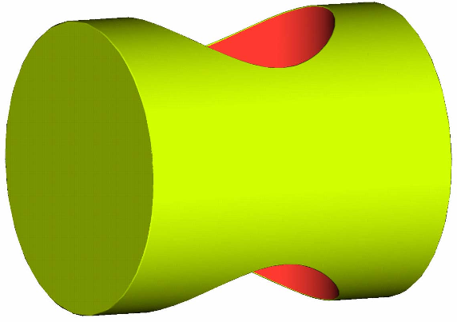

Slide 19
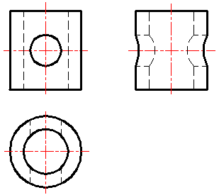
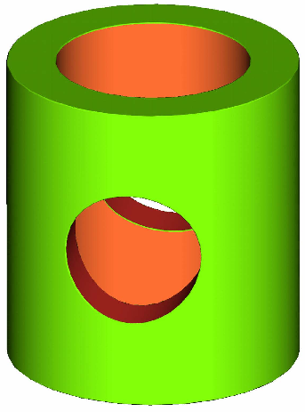

Slide 20
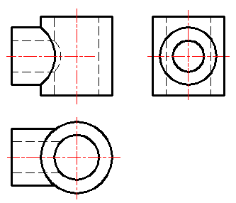
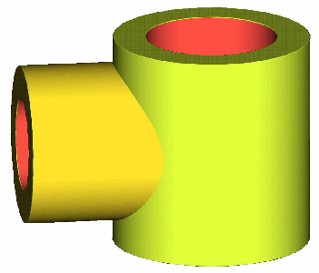

Slide 21
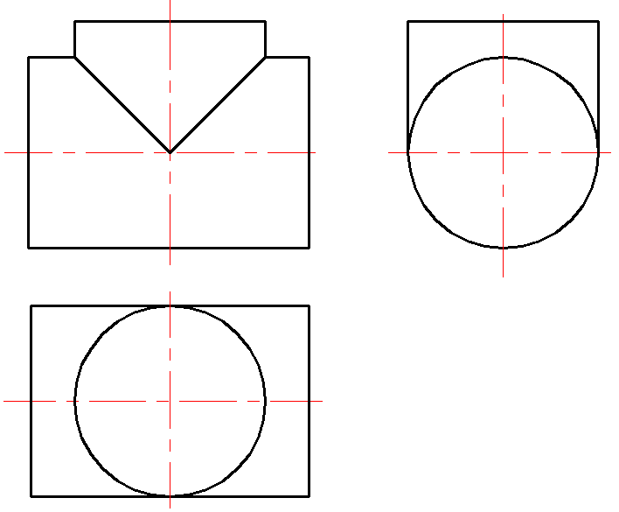
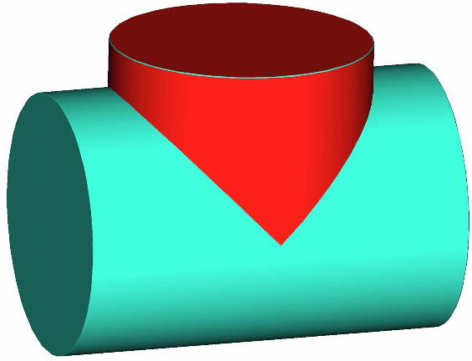

Slide 22
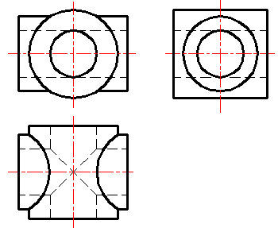
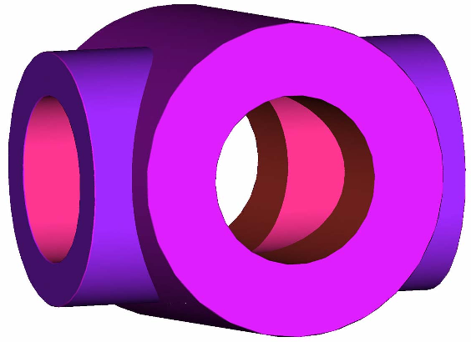

Slide 23
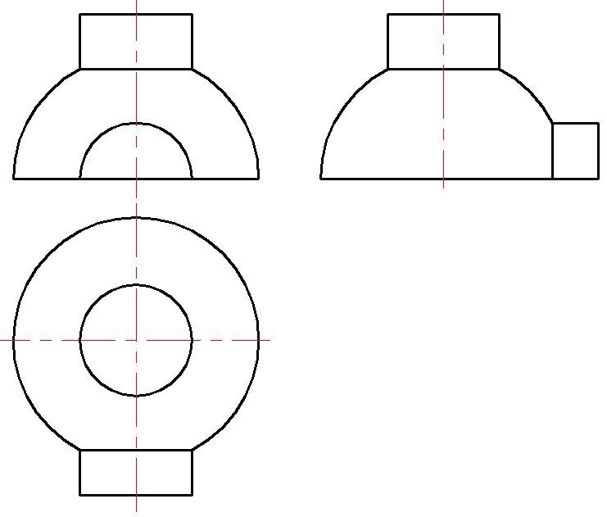
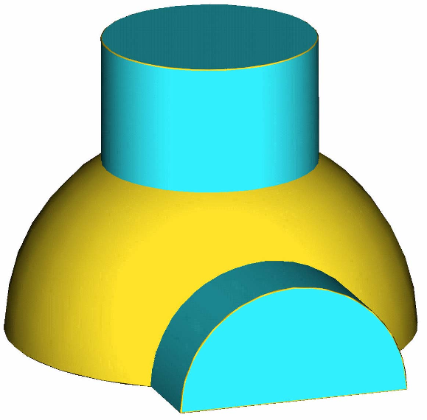

Slide 24
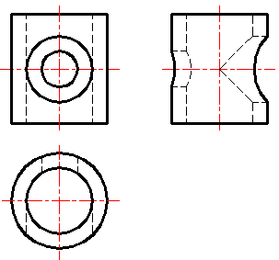
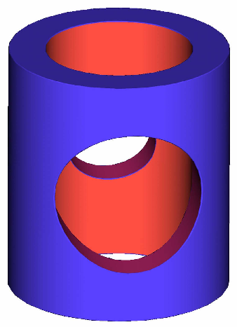

Slide 25
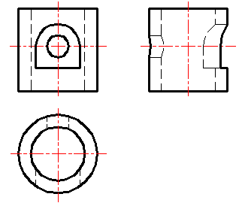
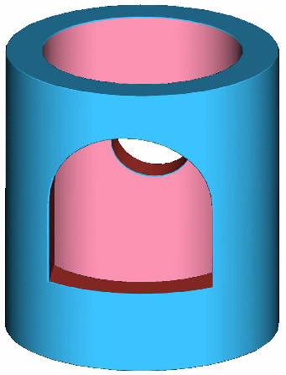

Slide 26
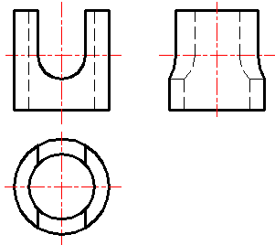
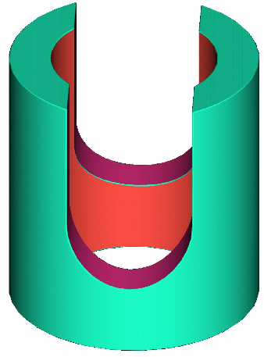

Slide 27
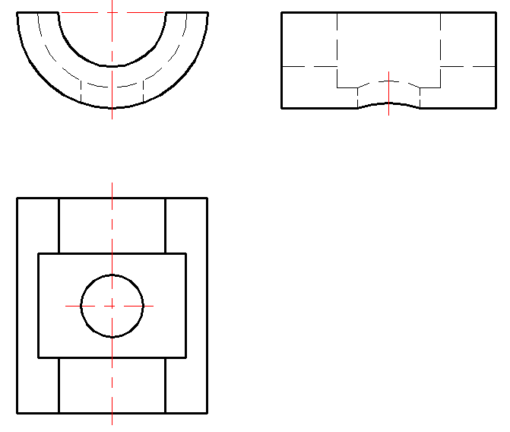
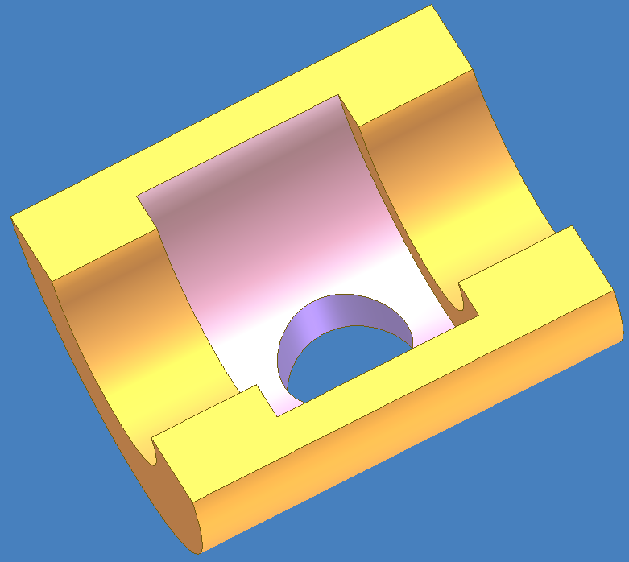

Slide 28
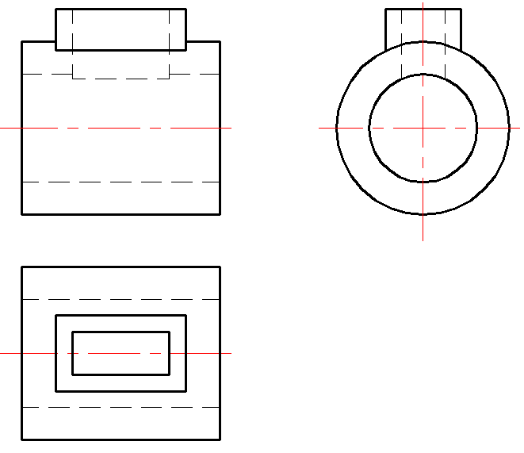


Slide 29


Slide 30


Slide 31


Slide 32


Slide 33


Slide 34


Slide 35


Slide 36


Slide 37


Slide 38


Slide 39


Slide 40


Slide 41


Slide 42


Slide 43



Slide 44



Slide 45



Slide 46



Slide 47


Slide 48


Slide 49


Slide 50



Slide 51



Slide 52



Slide 53



Slide 54



Slide 55



Slide 56



Slide 57



Slide 58


Slide 59


Slide 60


Slide 61



Slide 62



Slide 63



Slide 64



Slide 65


Slide 66


Slide 67


Slide 68


Slide 69


Slide 70


Slide 71


Slide 72


Slide 73


Slide 74


Slide 75


Slide 76


Slide 77


Slide 78


Slide 79


Slide 80



Slide 81



Slide 82



Slide 83



Slide 84


Slide 85


Slide 86


Slide 87



Slide 88


Slide 89



Slide 90



Slide 91



Slide 92



Slide 93



Slide 94



Slide 95



Slide 96



Slide 97



Slide 98



Slide 99



Slide 100



Slide 101



Slide 102



Slide 103


Slide 104



Slide 105



Slide 106



Slide 107


Slide 108


Slide 109


Slide 110



Slide 111



Slide 112


Slide 113




Slide 114


Slide 115


Slide 119


Slide 120


Slide 121


Slide 122


Slide 123


Slide 124


Slide 125


Slide 127


Slide 128


Slide 129

The End

